Slide 1
Congestion expeller
PRESENTED BY Glitter group 14

Slide 2
CONTENTS
part1
background
part2
purpose
part3
demo fabrication
part4
effect
part5
price estimation
part6
Risk solution
part8
links
part7
division of labor

Slide 3
Part 1
background

Slide 4
Glitter
“
In a large developing country such as China, urban expansion is an inevitable and rapid process, in such process, the traffic problem is expanding, in which the problem of traffic congestion is particularly prominent.
In order to reduce traffic congestion, we have developed a new type of private car starter Helper.

Slide 5
Part2
purpose

Slide 6
Glitter
“
Imagine a scene: A traffic light turned green into red, owner A saw and stepped on the brakes to slow down to stop, owner B saw owner A stop and step on the brakes to slow down to stop, after a period of time, owner A saw the red light turn green, and step on the throttle to speed up to the owner B to see the owner of A acceleration and step on the accelerator to speed up, the second car drive to the distance.

Slide 7
Part 3
demo fabrication

Slide 8
Design of Demo
“
Two cars for simplification
Three parts: traffic lights and two cars
Remote control as sender due to limitation
Show remaining time on cars
Move the prior car
Try to remain the distance between the two cars constant
Constant

Slide 9
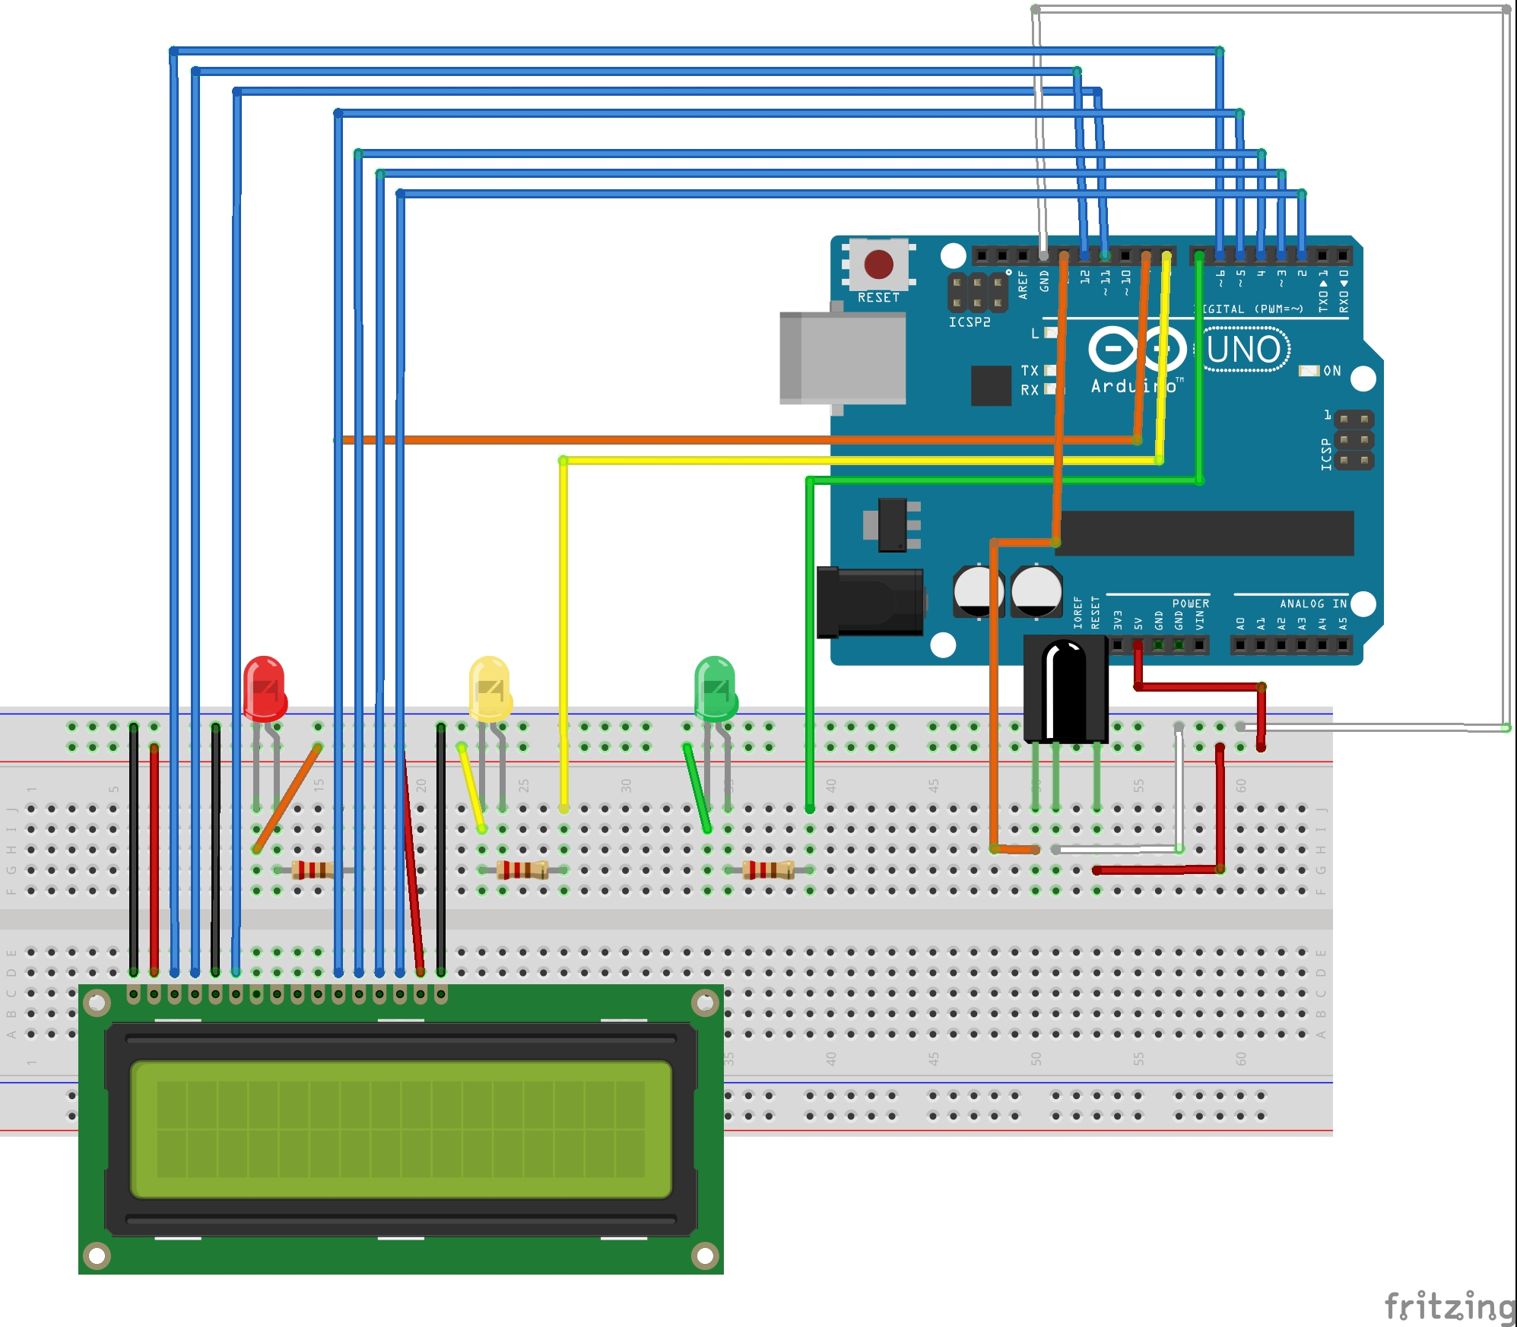
Wiring Diagram of Traffic Light
“
LCD to show the remaining time
Three LEDs with resistors for traffic lights
IR receiver

Slide 10
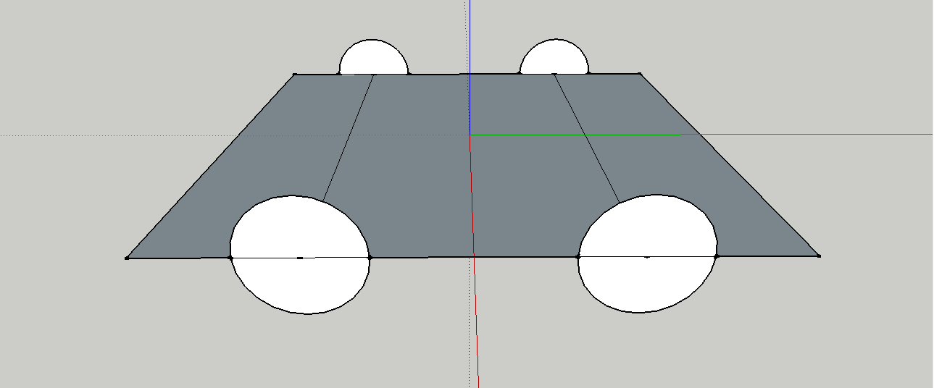
A Brief model for the cars
Driven Wheel
Driving Wheel
Equipment

Slide 11
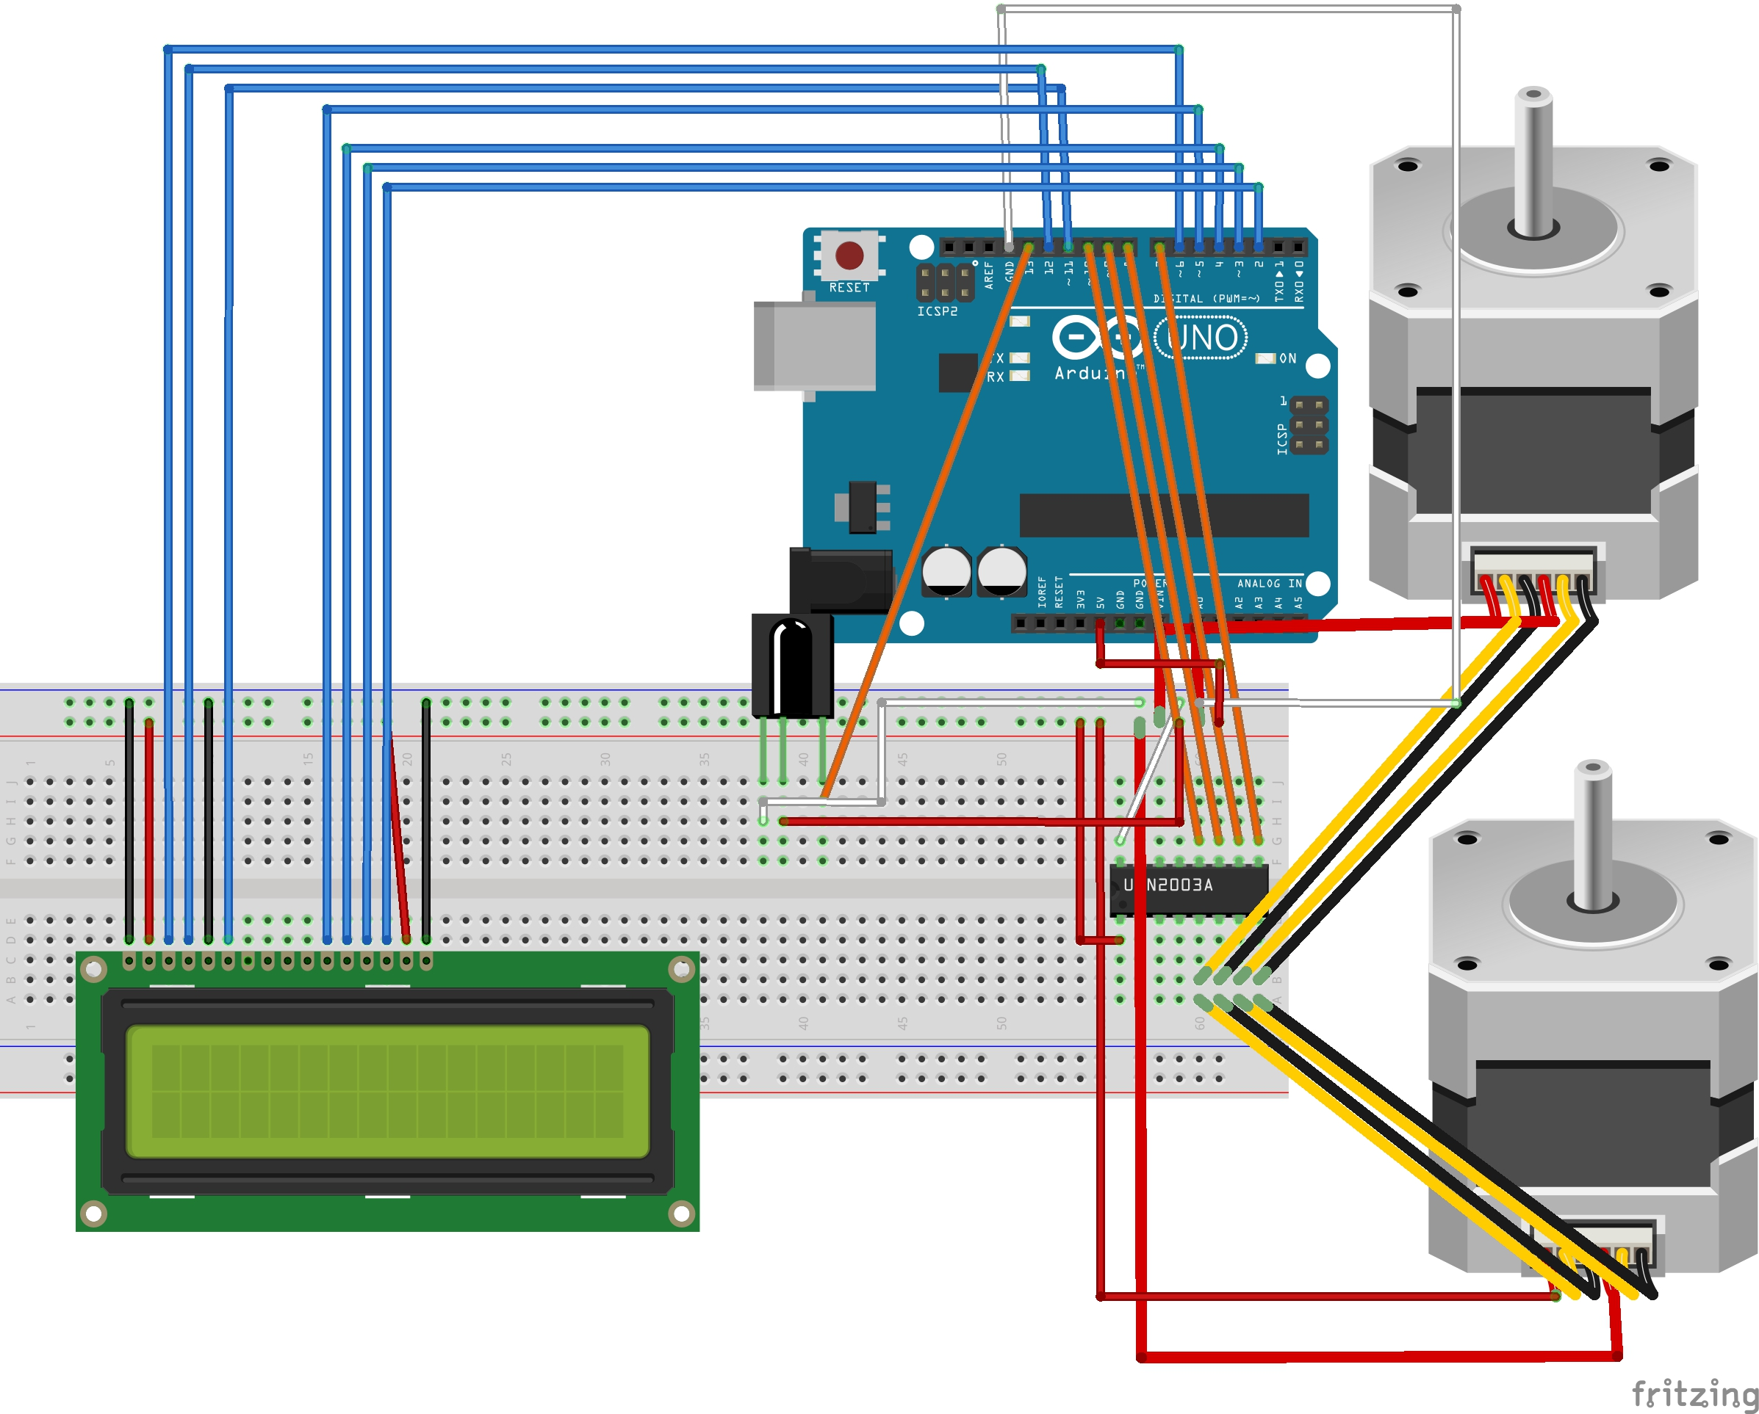
Wiring Diagram of Prior Car
“
Two Stepper to drive the car
ULN2003 driving chip for sufficient voltage

Slide 12
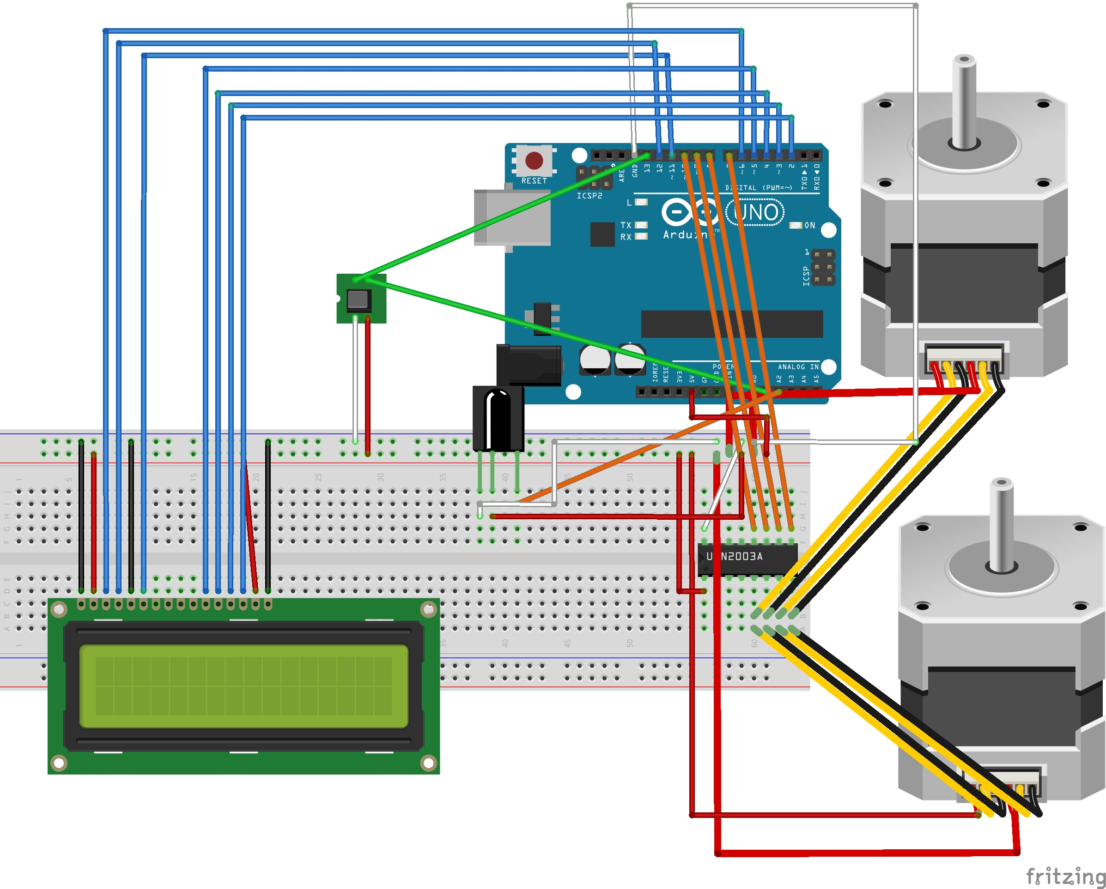
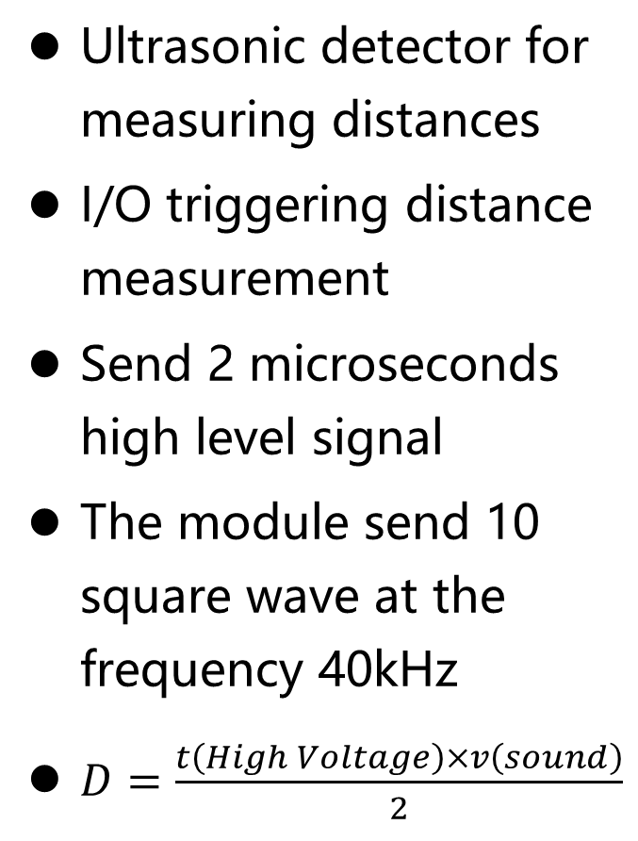
Wiring Diagram of Latter Car
“
Ultrasonic detector for measuring distances
I/O triggering distance measurement
Send 2 microseconds high level signal
The module send 10 square wave at the frequency 40kHz
$D=\frac{t\left(High Voltage\right)×v\left(sound\right)}{2}$

Slide 13
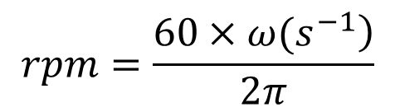
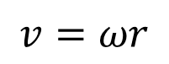
Techniques to Assure Constant Distance
Constant distance
Identical velocity
Rest at the beginning
Identical speed
Single direction
Very small time (0.02s)
ULM (Uniform Linear Motion)
Relative Speed
Calculate speed
Distance
Change of distance
$$v=ωr$$
Identical linear speed of the wheels
Stepper.setspeed(rpm)
$$rpm=\frac{\left.60×ω(s^{−1}\right)}{2π}$$

Slide 14
Part 4 effect

Slide 15
Glitter

Slide 16
Glitter
for private car owner
for the traffic line

Slide 17
Part 5
price estimation

Slide 18
Glitter
“
cost
set price

Slide 19
Part 6
Risk solution

Slide 20
“
1.Blue tooth message encryption transmission

Slide 21
Glitter
“
2.differences from unmanned driving

Slide 22
Part 7
division of labor

Slide 23
TEAMWORK
李嘉俊
郭畅达
CCO
3Dmodeling
BINGO!
MATHS MODELING
。
demo fabrication
唐启航
田肇阳

Slide 24
teamwork time table for 3 days
 | day 1 |  |  |  | day 2 |  |  |  | day 3 |  |  |  | day 4(presentation)
 | 1 | 2 | 3 | 4 | 1 | 2 | 3 | 4 | 1 | 2 | 3 | 4 | 1 | 2 | 3 | 4
TASK 1
TASK 2
TASK 3
TASK 4
TASK 5
=our goul

Slide 25
Part8
links

Slide 26
Glitter
“
https://www.1688.com/chanpin/-.html?spm=a261b.2187593.sea
http://oil.usd-cny.com/
http://i204.photobucket.com/albums/bb175/EddieOR/reactiontime.png
https://detail.1688.com/offer/540890664152.html?spm=a261b.

Slide 27
THANK YOU FOR YOU CAREFULLY LISTENNING
PRESENTED BY Glitter group 14

